Slide 1
Illuminating Insights for Global Electronics
By
Rajalakshmi Mathaiyan

Slide 2
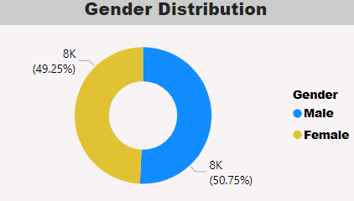
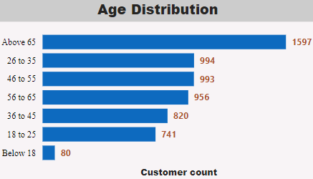
Customer Analysis
The Male customers are high when compared to female customers. We can do advertisement to attract more female customers.
From Age distribution, more number of customers are above 65 and also we can target the young people whose age from 26 to 35 to reach the high count as much as possible
From Continent distribution, North America is having high customers when compared to Eurpe and Australia.

Slide 3
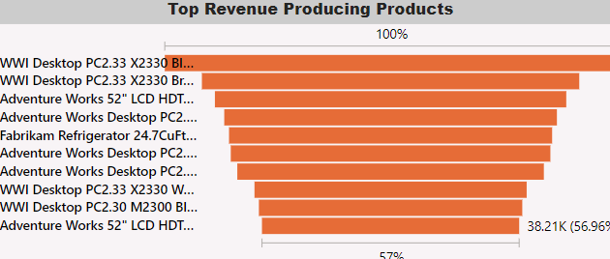
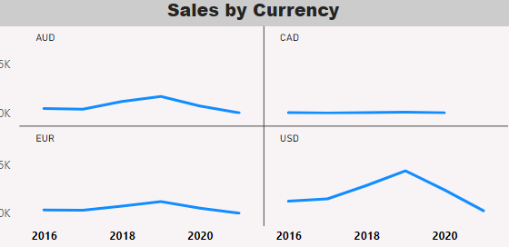
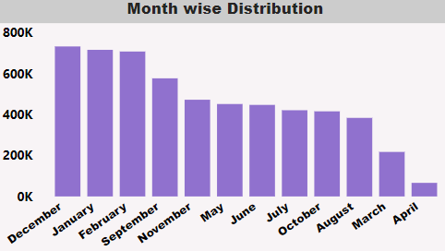
Sales Analysis
By Month wise distribution we can see that Jan, Feb and Dec are high in sales when compared to April and march so we can take some actions like giving discounts on April and march month so that sales may increase.
The top frequently bought products are from computers so we can concentrate more on having this products on stock.
The Sales trend is decreasing over time so we must have to concentrate on the increase of sales.

Slide 4
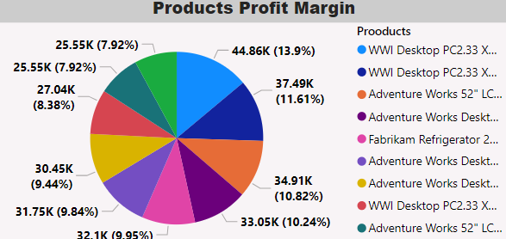
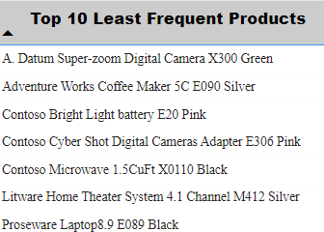
Product Analysis
The top 10 products are mostly from computers category and that too especially need to concentrate on colours. From Profit Margin, we can see most of the products profit are seems to be uniformly distributed.
The Least products are from home appliance categories we have to concentrate to increase the sale of home appliances.
By making the competitor analysis will help us in understanding the gaps in current products

Slide 5
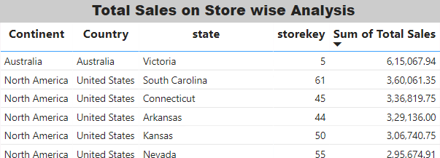
Store Analysis
From Store analysis, it has been understood that most of the sales occurred in North America and it has more number of stores also.
When compared to North America, single store from Australia has beaten the stores in North America on individual sale analysis.
There are very less number of stores in Australia.
Spreading the more number of stores in Australia can help the company grow on its sales.

Slide 6
Thank you

